Slide 1

Hotel Tango Application
By: Sam Stepter

Slide 2
Roadmap
We will discuss the architecture of .NET and SQL Server.
First, we will discuss how login authentication works.
Next, we will discuss the room and room type classes.
Next, we will discuss managing customer data.
Afterward we will discuss how reservations and WIFI codes are generated.
From there, we will discuss the automation handled by the database.

Slide 3
System Architecture
The System uses .NET Framework with C#
The database uses the SQL Server Database Engine

Slide 4
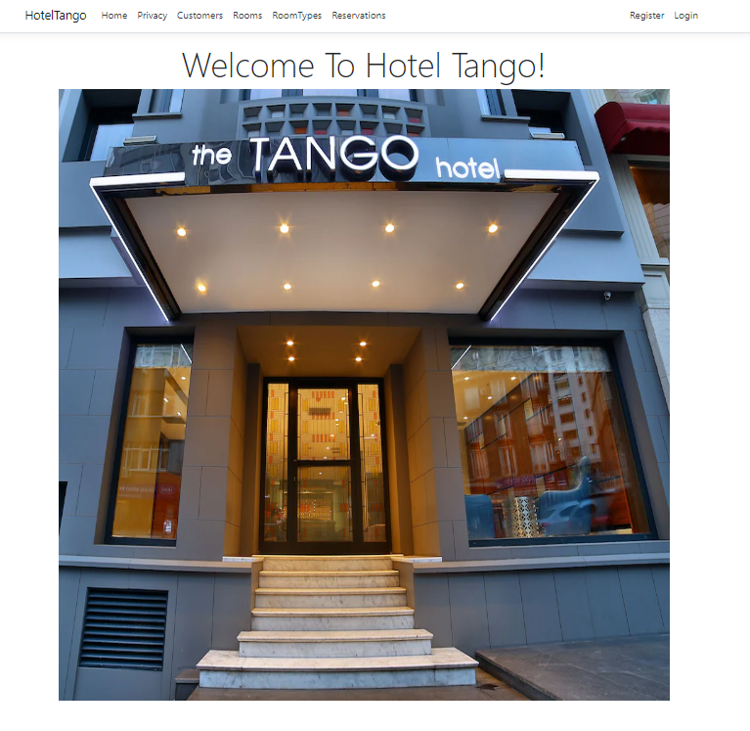
What Are We Trying To Solve?
As it stands Hotel Tango has to manually tend to reservations.
We want to create an inclusive app for employees to manage customers and reservations.
We want to cut down on human error.
We want to have the ability to perform data analytics on present and past reservations.

Slide 5
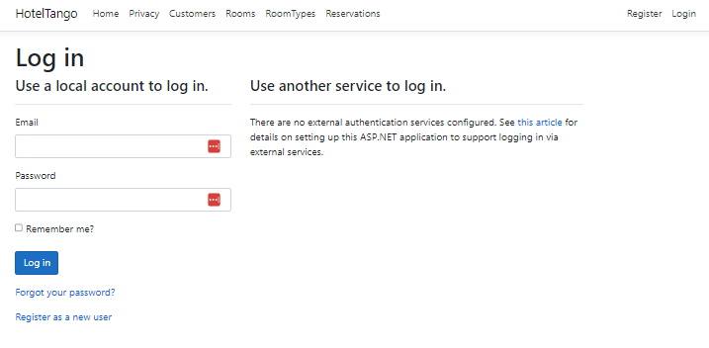
Login Authentication
Hotel Tango app can allow users to create their own logins to perform actions within the app.

Slide 6
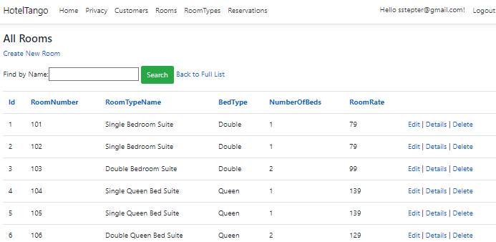
Manage Room and Room Types
On this slide, please view audio to view the description of the room feature.
Here we manage rooms and room attributes.

Slide 7
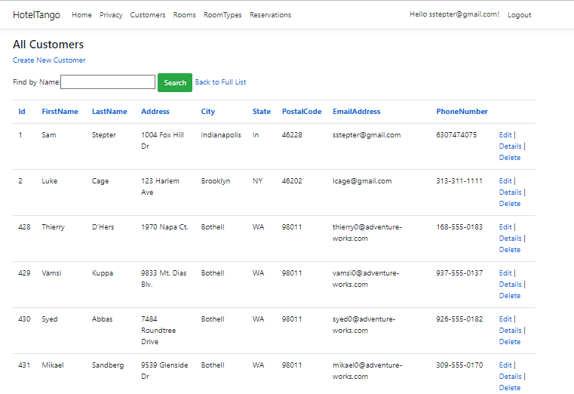
Manage Customer Data
Before having a reservation a customer must exist.
This window will allow us to manage all customer data for present and future reservations.

Slide 8
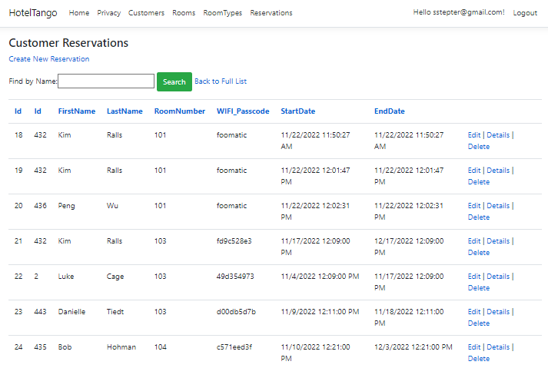
Manage Reservations
This screen looks at the available rooms and customers.
This is where we manage all reservations for customers.
Upon creating a reservation, we will email out the reservation.

Slide 9
The End

